Slide 1


SMART INDIA HACKATHON 2025
TITLE PAGE
Problem Statement ID – 25030
Problem Statement Title – AI-Based Crop Recommendation for Farmers.
Theme – Agriculture, FoodTech & Rural Development.
PS Category - Software
Team ID –
Team Name – CropNexus

Slide 2
IDEA TITLE
CROPNEXUS
IDEA / SOLUTION:
Implementation of a AI-powered mobile application gives farmers real-time crop advice using advanced machine learning on soil, weather, and market data, with multilingual and operate offline support in low-connectivity regions
AI-powered crop recommendation system using machine learning algorithms.
Uses satellite data for real-time soil and environmental analysis.
Recommends crops optimizing yield, profit, and sustainability.
Mobile app with multilingual chat, voice, and image interfaces.
Capability to work efficiently without internet even in low network zones.
PROBLEM RESOLUTION:
AI-driven crop recommendations → Solves soil & climate challenges by analyzing pH, rainfall, temperature, and market trends.
Multilingual voice & chatbot support → Bridges knowledge gaps, making advice accessible to all farmers.
Disease detection & sustainable practices → Boosts productivity while ensuring long-term soil health.
UNIQUE VALUE PROPOSITIONS (UPV):
Our solution uniquely combines hyper-local AI crop recommendations, real-time market insights, and image-based soil analysis in a multilingual, offline-ready mobile app—empowering farmers with actionable, science-backed decisions that boost income and ensure sustainable farming.

Slide 3



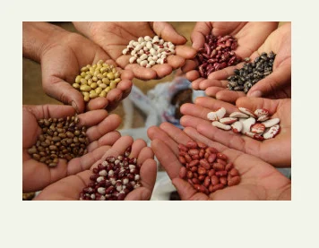
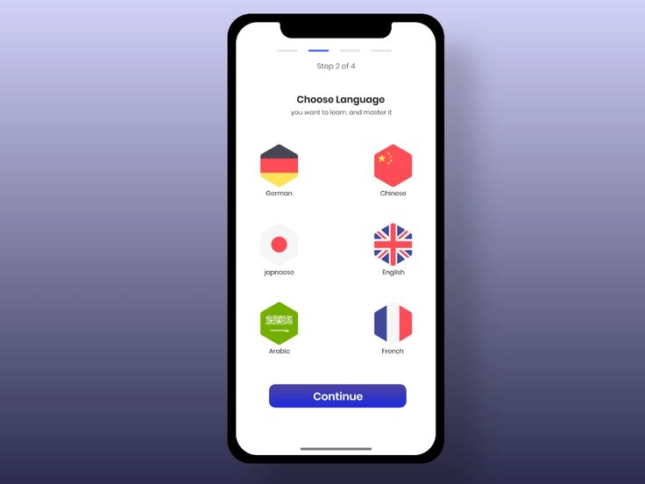
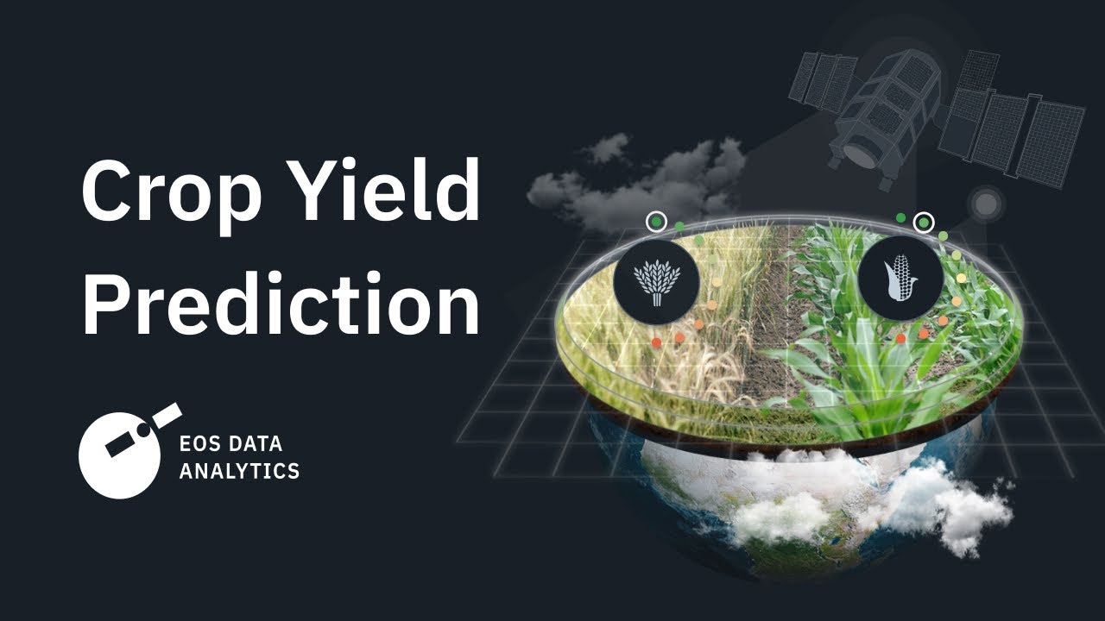


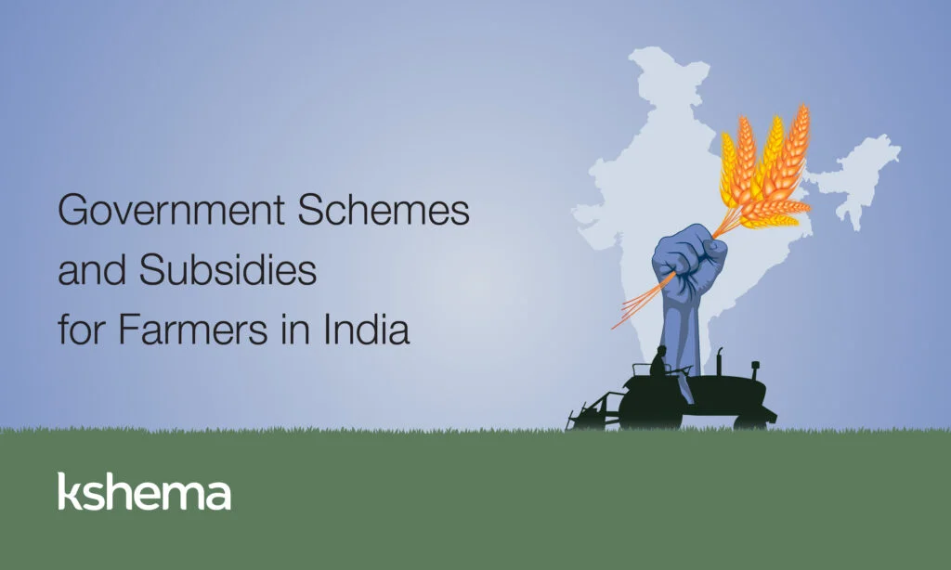
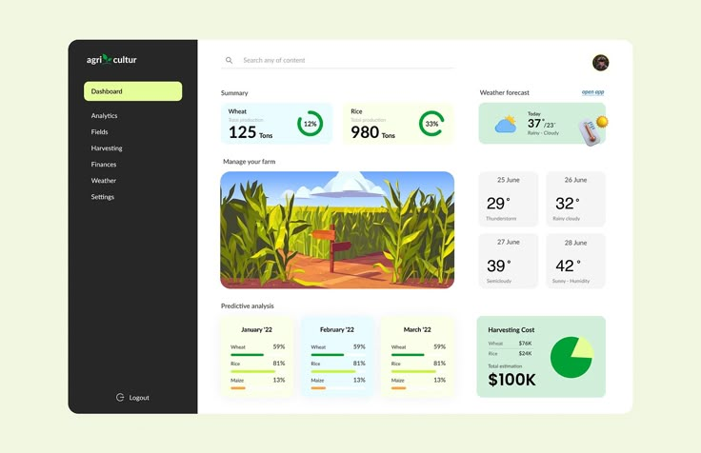








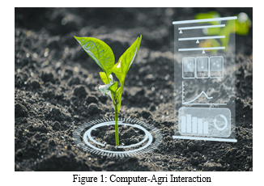
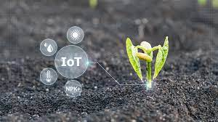
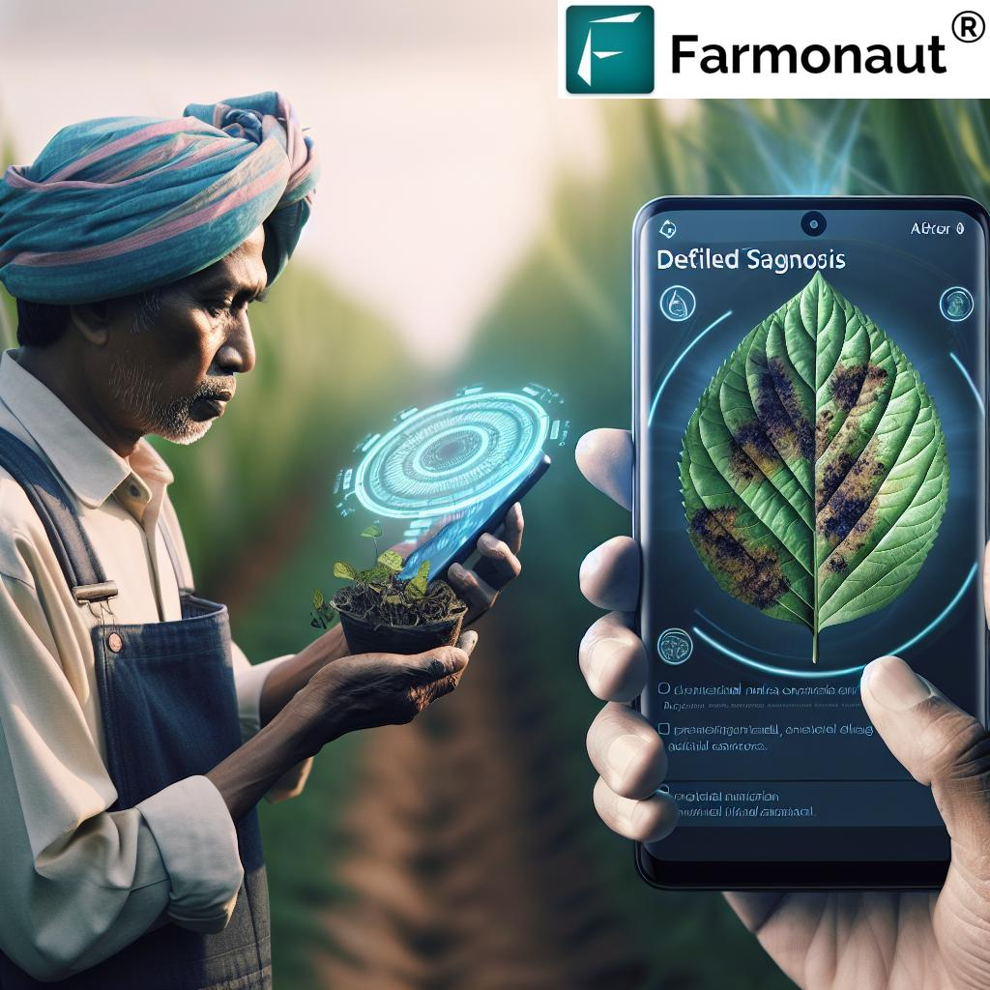
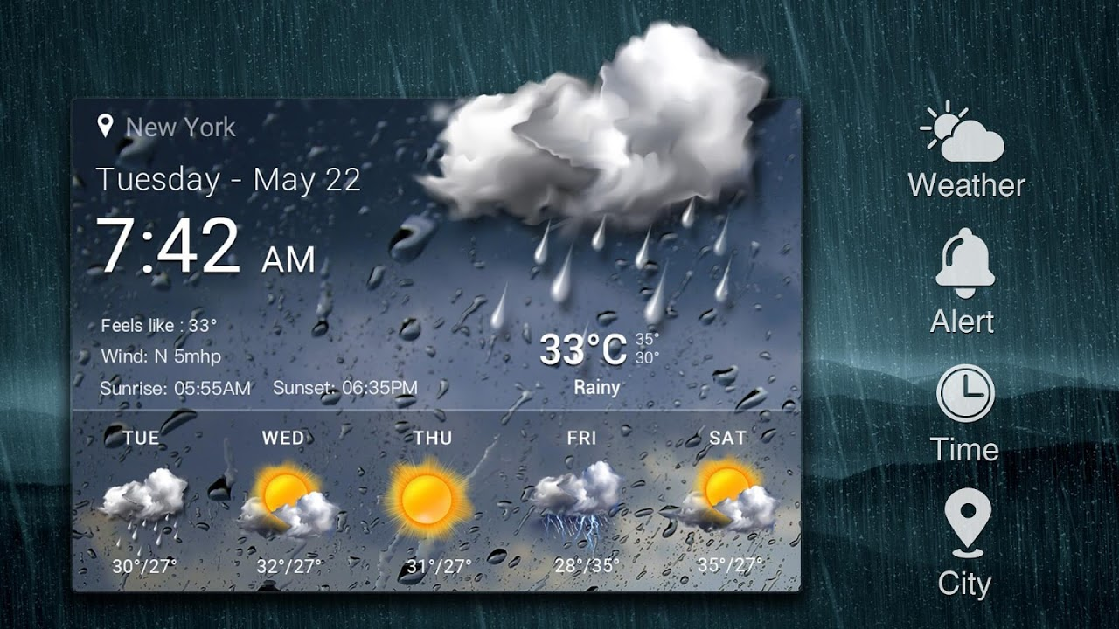
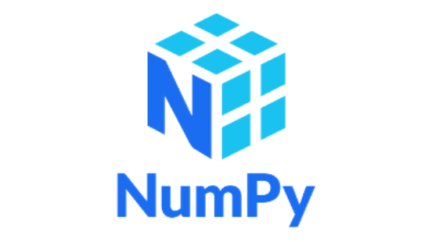







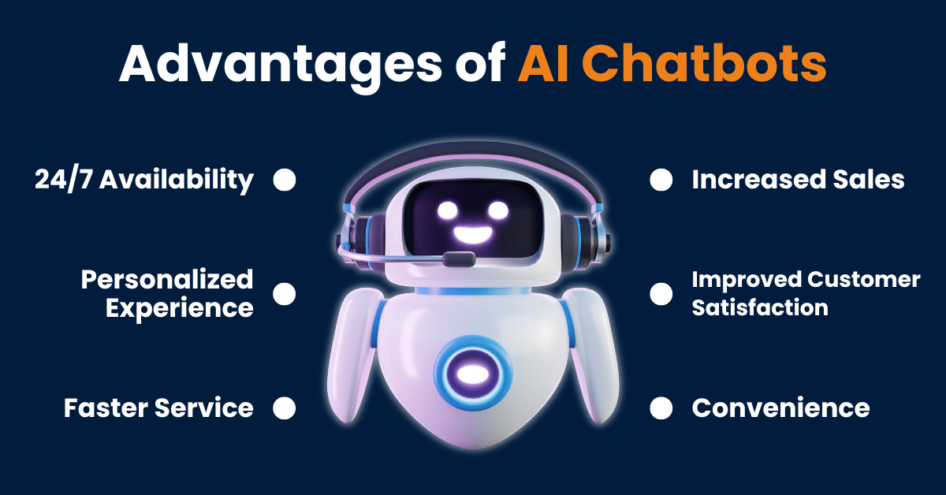

TECHNICAL APPROACH
CROPNEXUS
Algorithms Used :
Decision Tree Regression(Crop Recommendation)
Neural Networks(Yield & Profit prediction)
LSTM(Weather & time-series forecasting)
Security :
HTTPS , SSL/TLS(Secure Communication)
Bcrypt(Password encryption)
Deployment :
Vercel – Hosting frontend & APIs
Cloudinary – Image storage & optimization(soil images, datasets)
MongoDB Atlas – Managed cloud database
PROCESS FLOW ARCHITECTURE
Technology Stack
Frontend(Mobile App):
React Native – Cross-platform development(Android/iOS)
Tailwind CSS – Modern UI design
EJS – For dynamic rendering
Backend :
Node.js and Express.js – REST API development
MongoDB Atlas – Scalable, secure database
Socket.io – Real-time communication(chatbot, notifications)
JWT Authentication & CSRF Protection – Security
AI/ML(Artificial Intelligence and Machine Learning):
Python(ML core scripting)
NumPy, Pandas – Data Preprocessing
Scikit-learn – Classical ML models(Decision Tree, Regression)
TensorFlow – Deep Learning (CNN, LSTM, Neural Networks)
Matplotlib, Seaborn – Visualization
Flux – Neural Network experimentation
User opens the app
Login
Login success
Select language
Select 5 crop
Collected data store in the database
Crop yield
Location on
Database
Collected data store in the database
Stored data show on the dashboard
Government subsidy
FEATURES
Main dashboard
AI crop recommendation
AI soil help
AI plant disease detection
Weather check
Chatbot

Slide 4
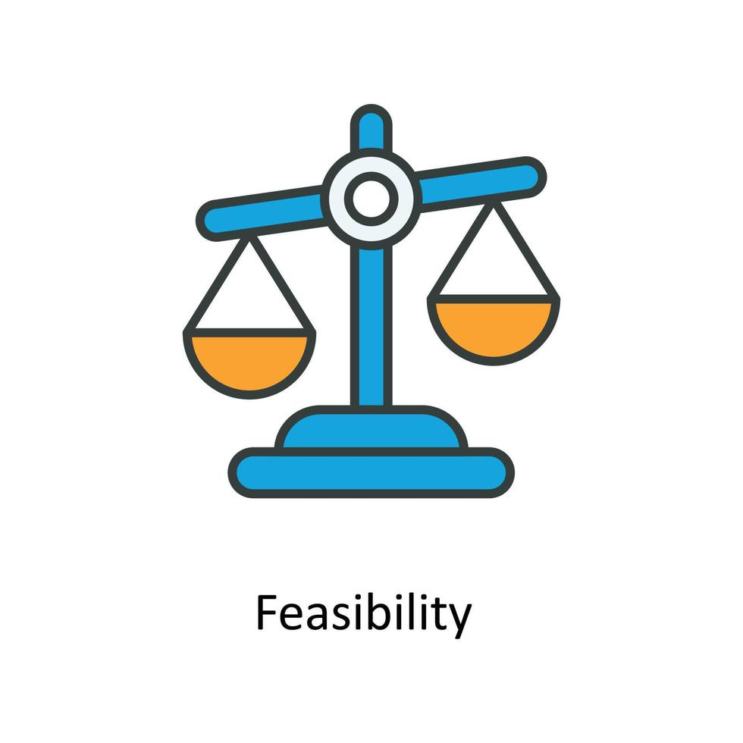





FEASIBILITY AND VIABILITY
CROPNEXUS
Technical → Uses proven tech (React Native, Python, TensorFlow, MongoDB, Cloud APIs).
Financial → Low infra cost (cloud-based, scalable, open-source stack).
Market → Huge demand in Indian AgriTech sector (farmers, gov. schemes, agri startups).
Operational → Mobile-first, multilingual support, simple UI → easy adoption by farmers.
Technical → Model accuracy, satellite data reliability.
Financial → Initial cloud hosting & model training costs.
Market → Farmer awareness & trust in AI solutions.
Operational → Internet connectivity in rural areas.
Methods → Hybrid AI (ML + Deep Learning + Rule-based).
Principles → Lean & agile development, iterative testing.
Strategies → Local language chatbot, offline caching, partnerships with agri-bodies.
Algorithms → Random Forest, LSTM, CNN, Decision Tree Regression for robust predictions.
Feasibility :
Use Cases:
AI Crop Recommendation & Yield Prediction → Farmer enters soil, weather, and crop data , app recommends the most profitable crop and predicts expected yield.
Plant Disease Detection & Treatment Suggestion →Farmer clicks a picture of an infected plant → AI detects the disease and suggests cure (fertilizer/pesticide).
Smart Market & Government Support →Farmer checks real-time crop prices, gets alerts for government subsidies, and plans sales accordingly.
Business Potential :
Target Market → 120M+ farmers in India.
Revenue Streams → Freemium model (basic free, premium analytics), agri-product ads, tie-ups with fertilizer/pesticide companies, gov. collaborations.
Scalability →Extend to global markets (Africa, SE Asia).
Challenges & Risks:
Strategies to Overcome:
Supporting Facts for Feasibility and Visibility
Indian AgriTech market = $24B opportunity by 2025.
AI-based yield prediction can reduce crop loss by up to 30%.
Government pushing Digital India & Smart Farming initiatives.

Slide 5
IMPACT AND BENEFITS
CROPNEXUS
Benefits of the solutions
✅ Benefits of the Solution :
Social Benefits :
Multilingual & voice-enabled → inclusive for rural, less literate users.
Strengthens farmer networks via community features.
Reduces reliance on middlemen for advice & pricing.
Economic Benefits:
Boosts farmer income through accurate yield & profit predictions.
Minimizes crop loss via early disease detection.
Provides real-time market prices for better selling decisions.
Environmental Benefits:
Promotes eco-friendly crop rotation & fertilizer use.
Saves water & energy through weather-aware resource planning.
Encourages sustainable farming practices.
Educational Benefits:
Farmers learn modern AI-backed farming methods.
Provides continuous awareness of government schemes & subsidies.
Enhances digital literacy among rural communities.
Technological Benefits:
Integrates AI + IoT + Computer Vision for precision farming.
Offers offline accessibility for low-connectivity rural areas.
Cloud-based architecture → scalable & future-ready platform.
Social
Environmental
Technological
Economic
Educational
🌍 Potential Impact on Target Audience :
Empowers farmers with AI-driven decision-making tools.
Enhances productivity & profitability through data-driven insights.
Builds a connected farmer community with knowledge sharing.

Slide 6
RESEARCH AND REFERENCES
CROPNEXUS
Primary Research Sources:
Elsevier (ScienceDirect) – Peer-reviewed journals on AI in Agriculture, Crop Prediction.
IEEE Xplore – Research papers on IoT-based smart farming and precision agriculture.
Springer – Studies on AI-driven soil analysis & plant disease detection.
Key Research Areas Referenced:
AI in Precision Agriculture → Crop yield prediction using ML models (Random Forest, LSTM).
Remote Sensing & Satellite Data → SoilGrids, Bhuvan APIs for soil & climate insights.
Computer Vision → CNN models for crop disease detection via images.
Sustainable Farming → Research on crop rotation, fertilizer optimization & eco-friendly practices.
Links of the reference and research work:
ScienceDirect (Elsevier): https://www.sciencedirect.com/
IEEE Xplore: https://ieeexplore.ieee.org/
Springer: https://link.springer.com/
FAO (Food & Agriculture Organization): https://www.fao.org/
📚 Literature Review
🔬 Data Collection
Research Workflow
🌱 Deployment & Use
⚙️ Prototype Implementation
🧪Model Development

